Slide 1











Official (Closed) - Non Sensitive
PROGRAMMING
FUNDAMENTALS
HTML CSS Advanced
DIPLOMA IN FULL-STACK DEVELOPMENT
Certificate in Computing Fundamentals
Continuing Education & Training (CET)

Slide 2
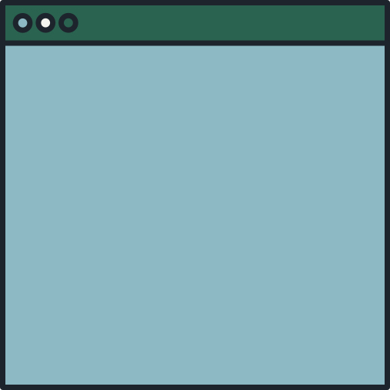

Official (Closed) - Non Sensitive
TODAY'S AGENDA
Media Queries
Box Model & Positioning
Flex
Continuing Education & Training (CET)

Slide 3
MEDIA QUERIES📱💻
Continuing Education & Training (CET)

Slide 4
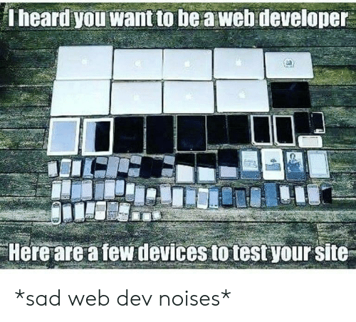
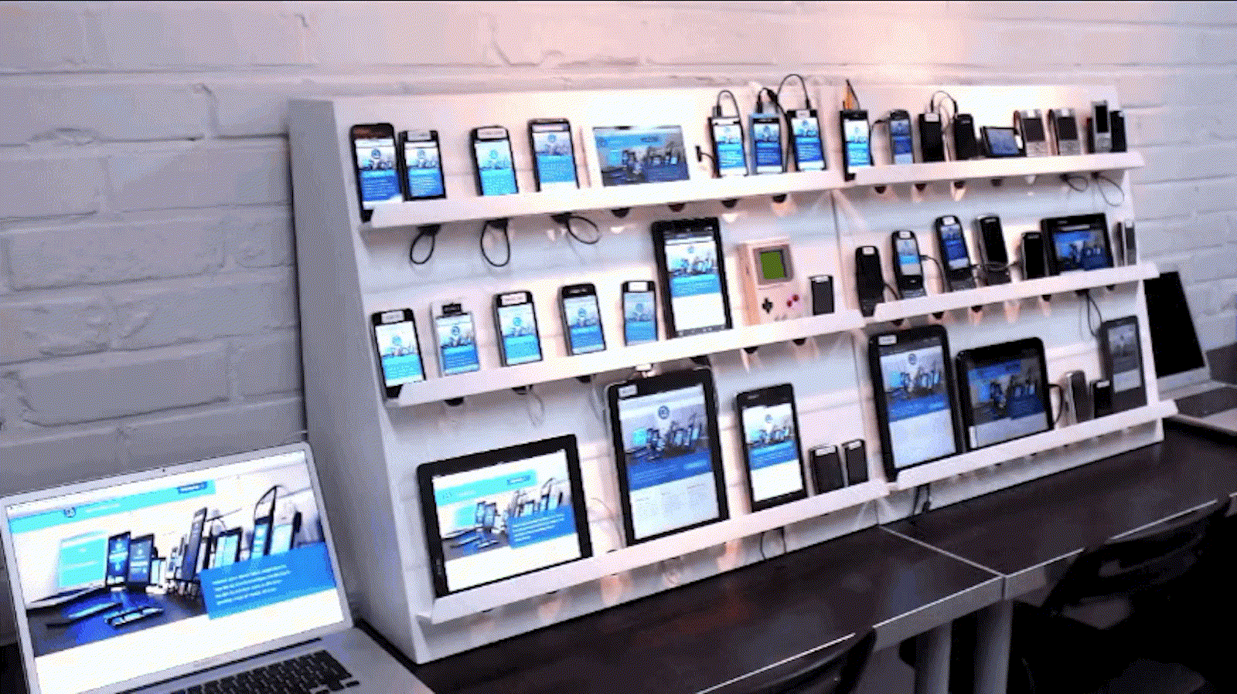

Testing across 27 devices
Notes:
A web dev life can be quite sad. We have to test across multiple devices and make everything look seamless.

Slide 5
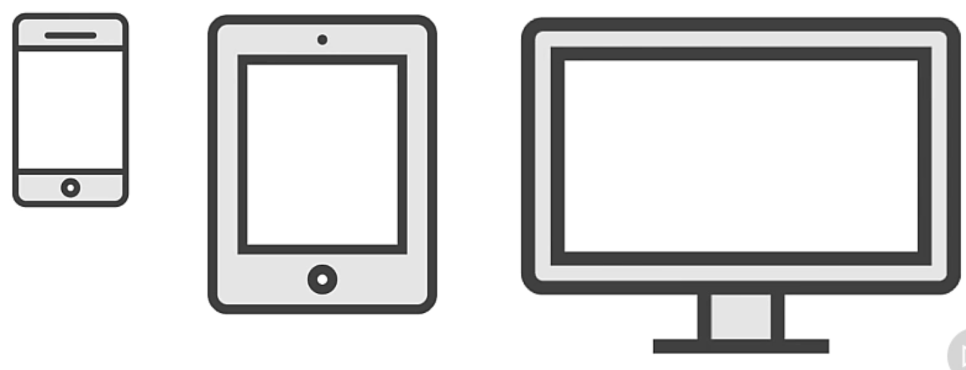
Official (Closed) - Non Sensitive
Mobile First Design
Media Query
Used to modify the CSS of a site depending on qualities such as viewport size or device type
@media
Applies one or more CSS properties based on the result of a media query
Min-width
If the minimum width of the viewport is at least the specific width or wider, then the media query is true
Max-width
If the maximum width of the viewport is at no more than the specified width, or it’s narrower then the media query is true
Notes:
By defining media queries, we can apply different CSS rules based on the devices
The viewport is the user's visible area of a web page.
The viewport varies with the device, and will be smaller on a mobile phone than on a computer screen.
Before tablets and mobile phones, web pages were designed only for computer screens, and it was common for web pages to have a static design and a fixed size.

Slide 6
Official (Closed) - Non Sensitive
@media rule
@media type
media feature
@media screen and (min-width: 576px) {
/* when the browser viewport is at least 576px apply rules here */
}
Continuing Education & Training (CET)
Notes:
We work with the @media rule and specify the screen type
Then we can work with the width specifications

Slide 7
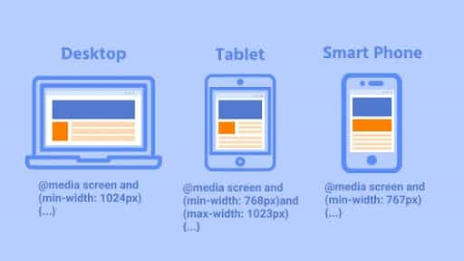
Official (Closed) - Non Sensitive
Official (Closed) - Non Sensitive
Mobile First Design
MEDIA TYPE
all: matches to all devices
print: matches to print and printer displays
speech: matches to speed reading devices that read out a page
screen: matches all devices that does not match print or speech
Common breakpoints
Reading: https://www.lambdatest.com/blog/how-to-use-css-breakpoints-for-responsive-design/
Notes:
Media types describe the general category of a device. Except when using the not or only logical operators, the media type is optional and the all type will be implied.
print
Intended for paged material and documents viewed on a screen in print preview mode. (Please see paged media for information about formatting issues that are specific to these formats.)
screen
Intended primarily for screens.
speech
Intended for speech synthesizers.

Slide 8
Official (Closed) - Non Sensitive
Media Features
Media features are used to test a specific feature of the device
@media (width: 480px){ }
@media (orientation: landscape){ }
Combining multiple types or features
@media (width: 480px) and @media (orientation: landscape) { }
https://developer.mozilla.org/en-US/docs/Web/CSS/Media_Queries/Using_media_queries

Slide 9
MEDIA QUERIES
Official (Closed) - Non Sensitive
h1{color: red;}
/* media query starts here */
/* Small devices (landscape phones, 576px and up) */
@media screen and (min-width: 576px) {
h1{color: green;}
}
/* Medium devices (tablets, 768px and up) */
@media (min-width: 768px) {
h1{color: blue;}
}
/* Large devices (desktops, 992px and up) */
@media (min-width: 992px) {
h1{color: purple;}
}
/* Extra large devices (large desktops, 1200px and up) */
@media (min-width: 1200px) {
h1{color: lightpink;}
}
https://replit.com/@immalcolm/simple-media-queries
Continuing Education & Training (CET)
Notes:
Is this painful to you? When do we use it. It depends on the use case, whether we want separate style sheets for different device sizes. Or just minor changes when it’s on a mobile screen size
Luckily we have frameworks available to help us with this.
https://replit.com/@immalcolm/simple-media-queries

Slide 10
Modern Frontend
Web Dev
CSS Positioning
Bootcamp on Modern Frontend Web Dev. with Javascript

Slide 11

Official (Closed) - Non Sensitive
Objectives
Learn about advanced positioning in CSS
Relative, Absolute, Fixed
Flexbox

Slide 12
MEASUREMENT

Slide 13
Relative to the font-size of the root (e.g. the <html> element). “rem” = “root em”
MEASUREMENT
Absolute
Measurement does not rely on another.
By Units
Absolute
Relative
cm | Centimeter
mm | Milimeters
in | Inches
px | Pixels
pt | Points
pc | Picas
em | Browser default font-size E.g Relative to the current font-size of the element
rem | Relative to root element (html) font-size.
vw | 1% to width of viewport
vh | 1% to height of viewport
% | To parent element
Relative
Measurement is with relation to something else.
https://developer.mozilla.org/en-US/docs/Learn/CSS/Building_blocks/Values_and_units
https://www.digitalocean.com/community/tutorials/css-css-units-explained
Notes:
Depending on what we are going out for, we can use different measurement units .

Slide 14
POSITIONING

Slide 15
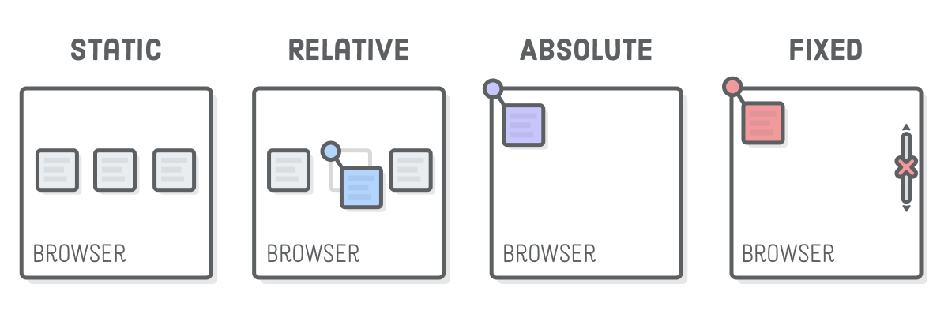
Official (Closed) - Non Sensitive
Positioning
CSS position property lets you alter the positioning scheme of a particular element.
Source: https://internetingishard.com/html-and-css/advanced-positioning/

Slide 16
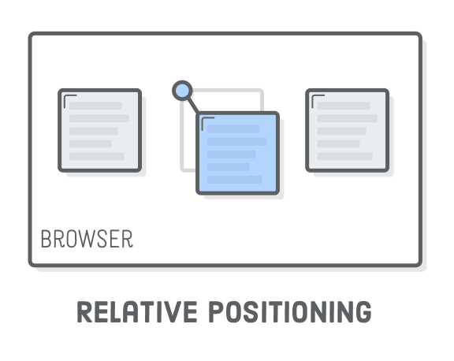
Official (Closed) - Non Sensitive
Relative Position
Moves elements around relative to where they would appear on the page.
Uses
Nudging boxes around
Source: https://internetingishard.com/html-and-css/advanced-positioning/
Notes:
https://www.w3schools.com/cssref/playit.asp?filename=playcss_position&preval=relative

Slide 17
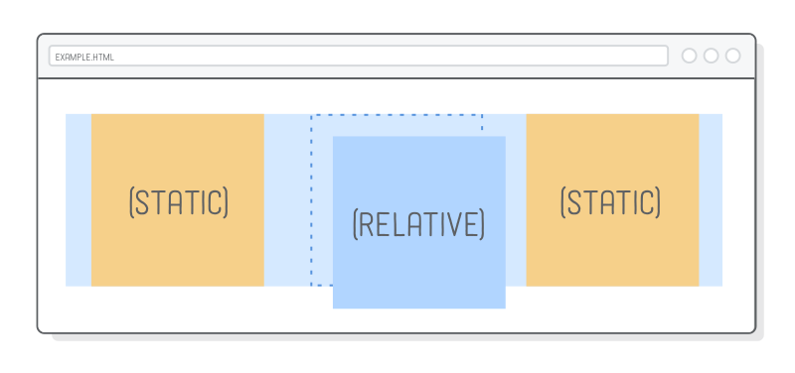
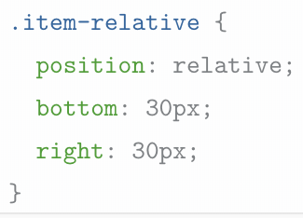
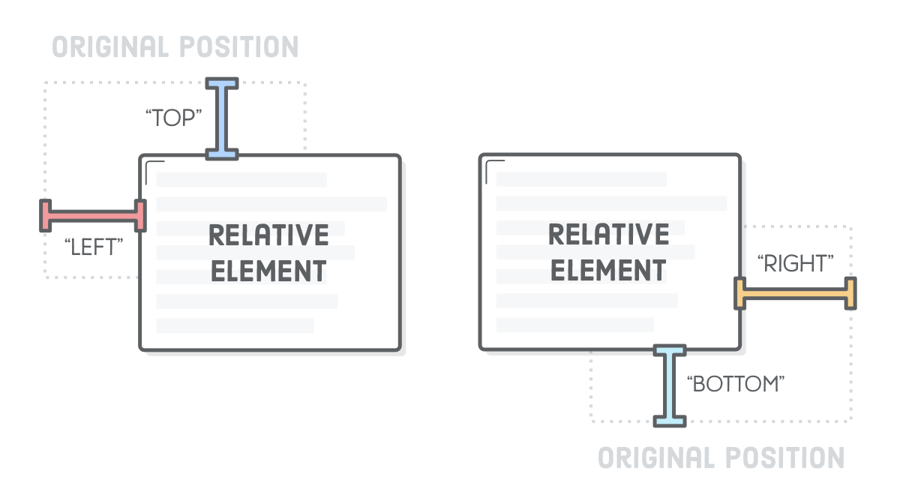
Official (Closed) - Non Sensitive
Relative Position
Think of the offsets as being applied after the browser finishes laying out the page.
Uses Top, Left, Right, Bottom properties
https://replit.com/@immalcolm/simple-positioning
Source: https://internetingishard.com/html-and-css/advanced-positioning/
Notes:
https://www.w3schools.com/cssref/playit.asp?filename=playcss_position&preval=relative

Slide 18
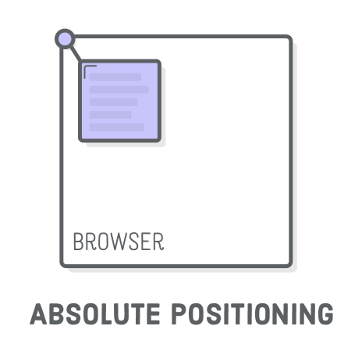
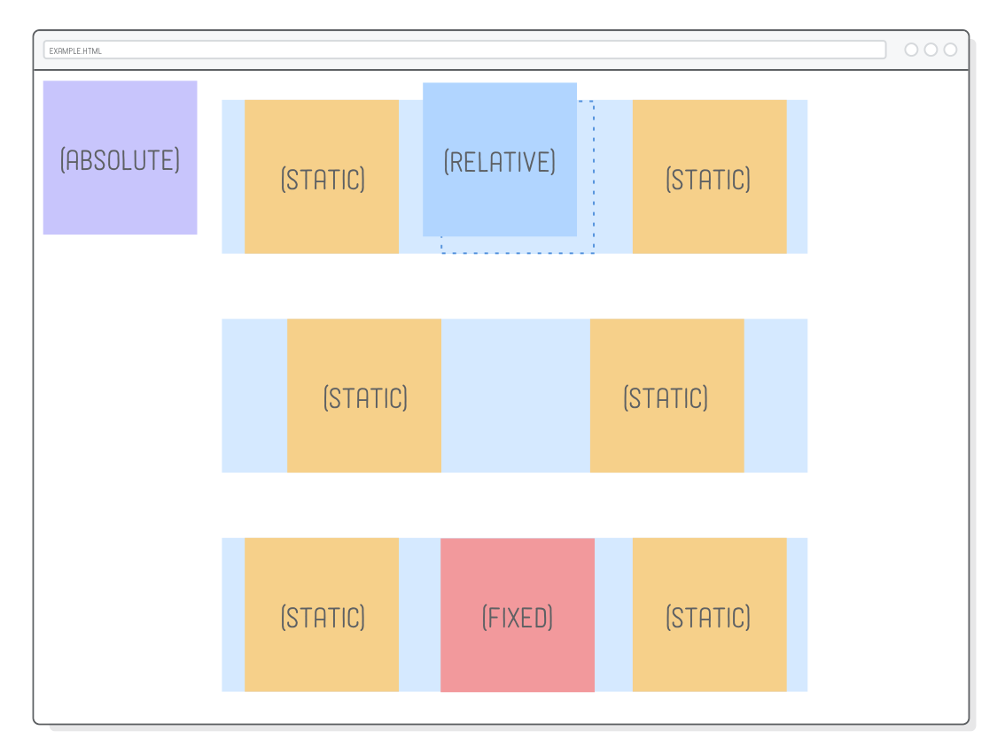
Official (Closed) - Non Sensitive
Absolute Position
Offset is relative to the entire browser window instead of the original position of the element.
Absolute position elements are placed in relation to a parent content(browser viewport, or parent element). The parent is the positioning context
Positions can be modified using positioning offsets, top, right, bottom, left
Reading
https://css-tricks.com/almanac/properties/p/position/
https://replit.com/@immalcolm/simple-positioning
Source: https://internetingishard.com/html-and-css/advanced-positioning/
https://developer.mozilla.org/en-US/docs/Web/CSS/position
Notes:
Elements with absolute positioning are neither affected by or do not affect other elements in the normal flow of the page.
They are like layers in Photoshop or Illustrator; you're free to place them anywhere you wish on the page.
Positioned elements rely on you telling the browser where to place them, using values called positioning offsets, for the element's top, right, bottom or left position.
When you use absolute positioning, you place the absolutely positioned elements in relation to a parent container; the parent container is the positioning context.
You can change the positioning context to other containing elements; this lets us position elements precisely where we want them.
https://www.w3schools.com/cssref/playit.asp?filename=playcss_position&preval=absolute

Slide 19
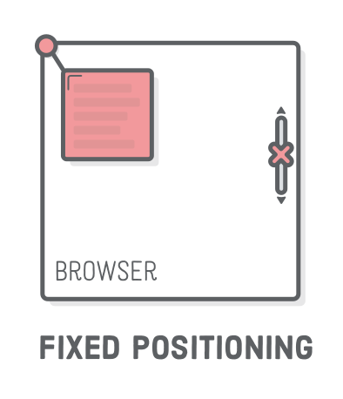
Official (Closed) - Non Sensitive
Fixed Position
Very similar to absolute EXCEPT that
Fixed elements don't scroll with the rest of the page.
Commonly known as sticky elements.
https://repl.it/@malcolmyam/simple-positioning#index.html
Source: https://internetingishard.com/html-and-css/advanced-positioning/
Notes:
https://www.w3schools.com/cssref/playit.asp?filename=playcss_position&preval=fixed

Slide 20
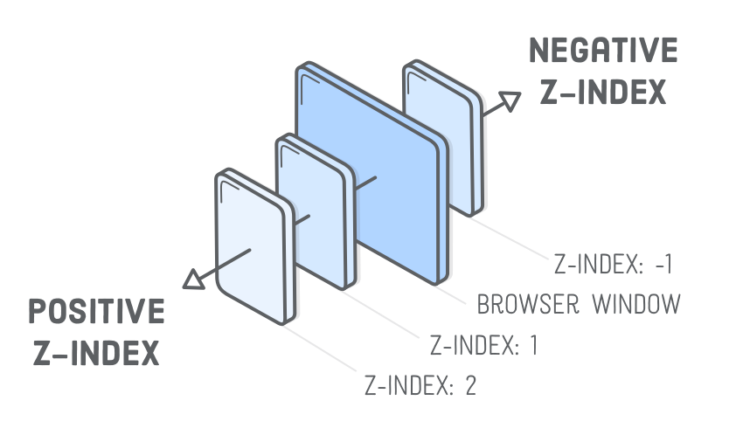
Official (Closed) - Non Sensitive
Z-Index
z-index property lets you control the depth of elements on the page.
Imagine the screen as a 3D world
Negative z-index go farther into the page. (behind)
Positive z-index comes out of the page
Source: https://internetingishard.com/html-and-css/advanced-positioning/
Simple z-index demo
Z-index animation demo
Z-index Reading
https://developer.mozilla.org/en-US/docs/Web/CSS/z-index
https://philipwalton.com/articles/what-no-one-told-you-about-z-index/
https://developer.mozilla.org/en-US/docs/Web/CSS/CSS_Positioning/Understanding_z_index/The_stacking_context
https://css-tricks.com/almanac/properties/z/z-index/
Notes:
Treat z-index like your photoshop/illustrator layers. It works in a very similar way.
It’s called z-index because it affects elements upon the z-axis
You can position elements using relative, absolute, relative. Specifying top left bottom right.

Slide 21
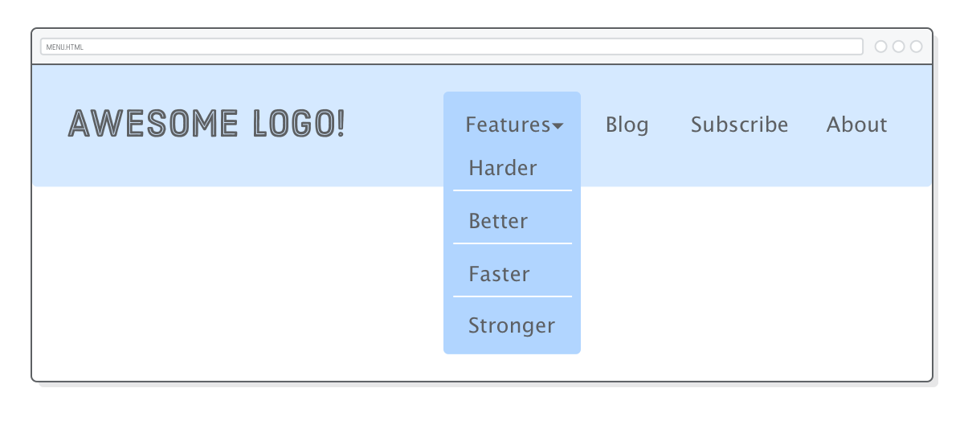
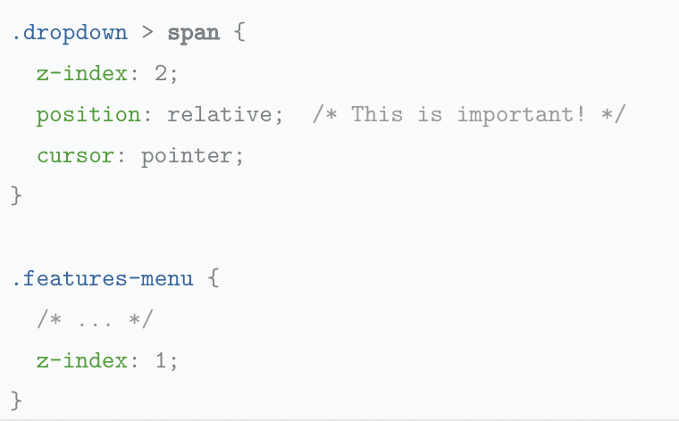
Official (Closed) - Non Sensitive
Z-Index
Source: https://internetingishard.com/html-and-css/advanced-positioning/
Simple z-index demo
Z-index animation demo
Z-index Reading
https://developer.mozilla.org/en-US/docs/Web/CSS/z-index
https://philipwalton.com/articles/what-no-one-told-you-about-z-index/
https://developer.mozilla.org/en-US/docs/Web/CSS/CSS_Positioning/Understanding_z_index/The_stacking_context
https://css-tricks.com/almanac/properties/z/z-index/
Notes:
Zindex is commonly used in layer navigation elements or maybe your modal popups
Z-index relates to the stacking order
It’s called z-index because it affects elements upon the z-axis
Simple z-index demo: https://repl.it/@malcolmyam/wk03-zindex-test#style.css
Z-index animation demo: https://repl.it/@malcolmyam/wk03-zindex-animation#index.html

Slide 22
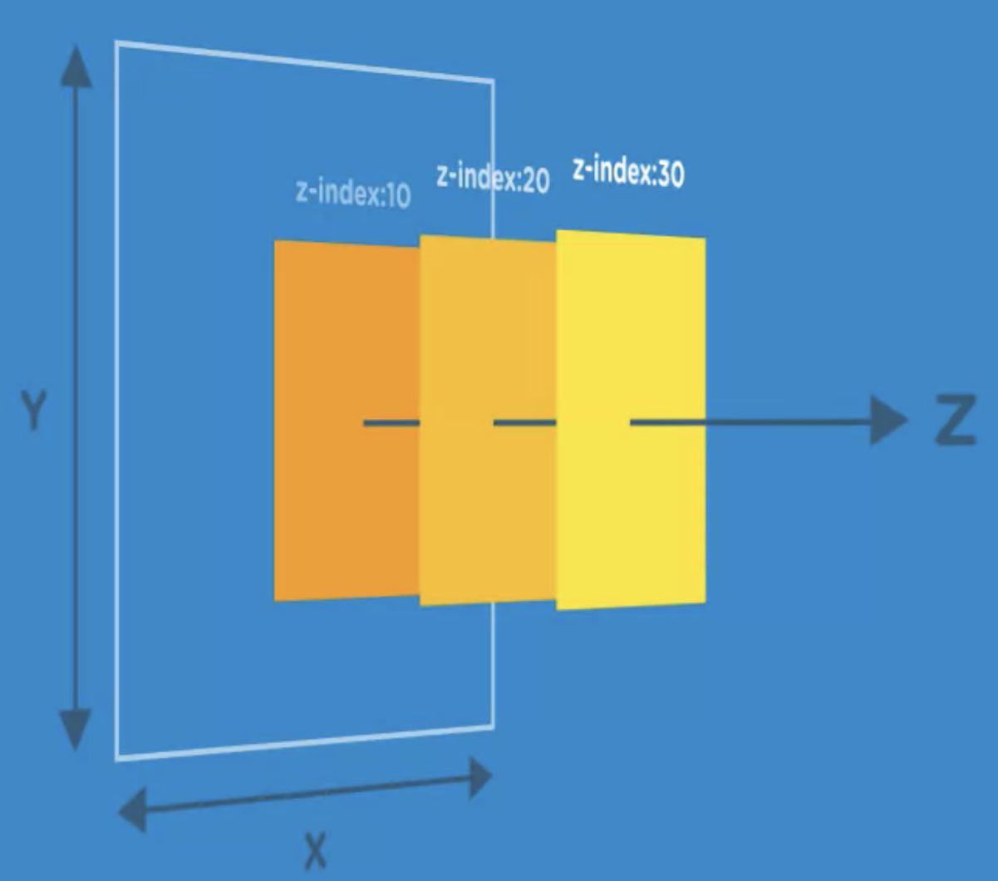
Official (Closed) - Non Sensitive
Positioned elements follow a stacking order that determines which elements display above or below other elements.
The z-index property is directly related to stacking order and it's what prevents elements from overlapping other elements.
An element with a higher z-index value overlaps an element with a lower z-index value.
Positioned elements have a z-index of 0 by default.
z-index work ONLY on elements with a position property set to absolute, fixed, or relative.If you set a z-index on an element with no position, it will do nothing.

Slide 23
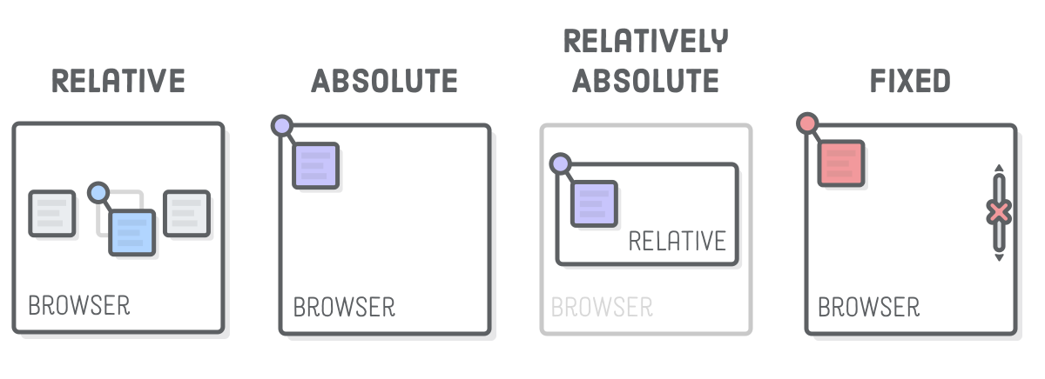
Official (Closed) - Non Sensitive
Positioning
Relative
For tweaking the position of an element without affecting its surrounding boxes
Absolute
Take elements out of the static flow of the page and place relative to the browser window
Relative Absolute
Allows us hook back into the static flow of the page
Fixed
Make elements don't scroll with the rest of the page (sticky)
Source: https://internetingishard.com/html-and-css/advanced-positioning/
Notes:
https://www.w3schools.com/cssref/playit.asp?filename=playcss_position&preval=fixed

Slide 24
FLEXBOX

Slide 25
FLEXBOX
The flexbox container is the parent of the flex item.
The children of the flexbox container can be laid out in horizontal or vertical easily and flex their size when the content grows or shrink accordingly
Flexbox Container
Official (Closed) - Non Sensitive
Flex Item
Flex Item
Flex Item
https://www.w3schools.com/css/css3_flexbox.asp
https://css-tricks.com/snippets/css/a-guide-to-flexbox/
Notes:
Made up of two key parts.
Flexbox container and flex item
https://www.w3schools.com/css/css3_flexbox.asp
A flex container is the parent object and contains flex items inside of the parent container
Flex items - primary objects within the flex container
Flexbox can be used to define the attributes and layout of the flex items
Flex items - primary objects within the flex container

Slide 26
FLEXBOX
Apply flexbox to get flexible layouts
Flexbox Container
Official (Closed) - Non Sensitive
Flex Item
Flex Item
Flex Item
https://www.w3schools.com/css/css3_flexbox.asp
https://css-tricks.com/snippets/css/a-guide-to-flexbox/
Notes:
Made up of two key parts.
Flexbox container and flex item
https://www.w3schools.com/css/tryit.asp?filename=trycss3_flexbox_flex-wrap_nowrap8
A flex container is the parent object and contains flex items inside of the parent container
Flex items - primary objects within the flex container

Slide 27
Flexbox Container
Can adapt layout to suit content
Official (Closed) - Non Sensitive
FLEXBOX
Flex Item
Flex Item
Flex Item
https://www.w3schools.com/css/css3_flexbox.asp
https://css-tricks.com/snippets/css/a-guide-to-flexbox/
Notes:
You can always change the layout of the flexbox container

Slide 28

Official (Closed) - Non Sensitive
FLEXBOX
https://www.w3schools.com/css/css3_flexbox.asp
https://css-tricks.com/snippets/css/a-guide-to-flexbox/
Notes:
Flex is able to adapt regardless of platform type. It is now become of the most mainstream way of creating layouts

Slide 29
Official (Closed) - Non Sensitive
FLEXBOX: Breakdown a Design
Look at the entire page
See how all main children stack
Start breaking down each row and column
Stop when you can’t break it down to stacks
https://css-tricks.com/snippets/css/a-guide-to-flexbox/

Slide 30
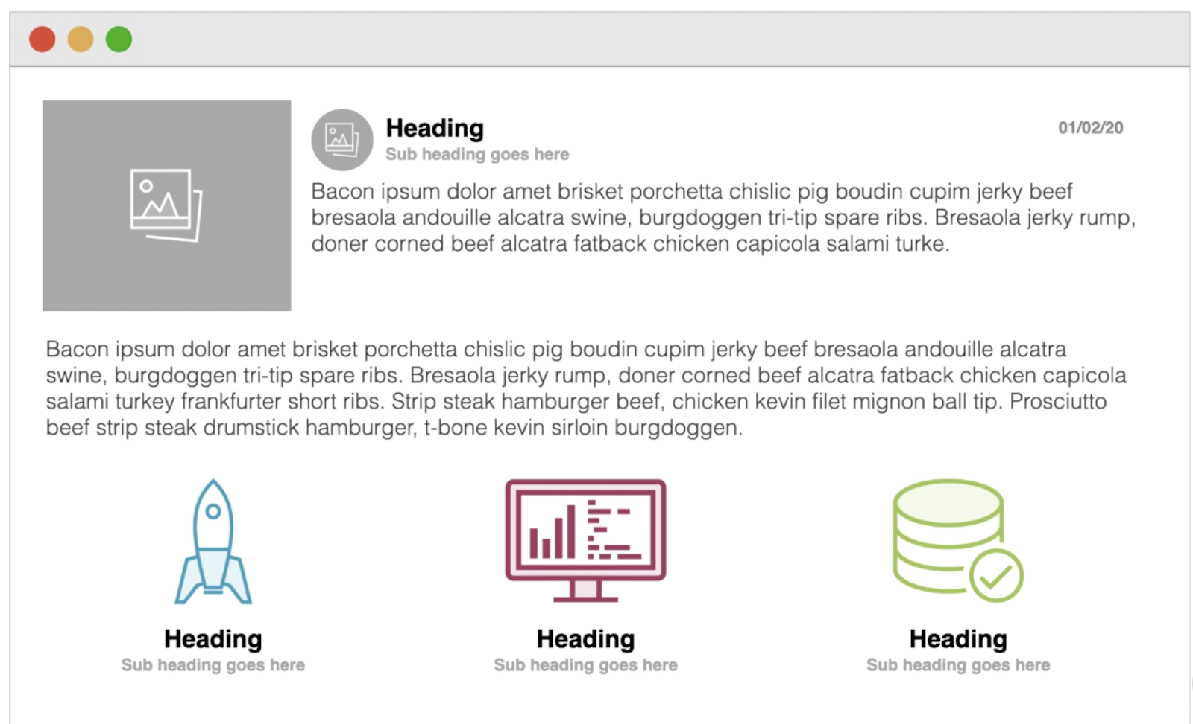
Official (Closed) - Non Sensitive

Slide 31
Official (Closed) - Non Sensitive

Slide 32
Official (Closed) - Non Sensitive

Slide 33
Official (Closed) - Non Sensitive

Slide 34

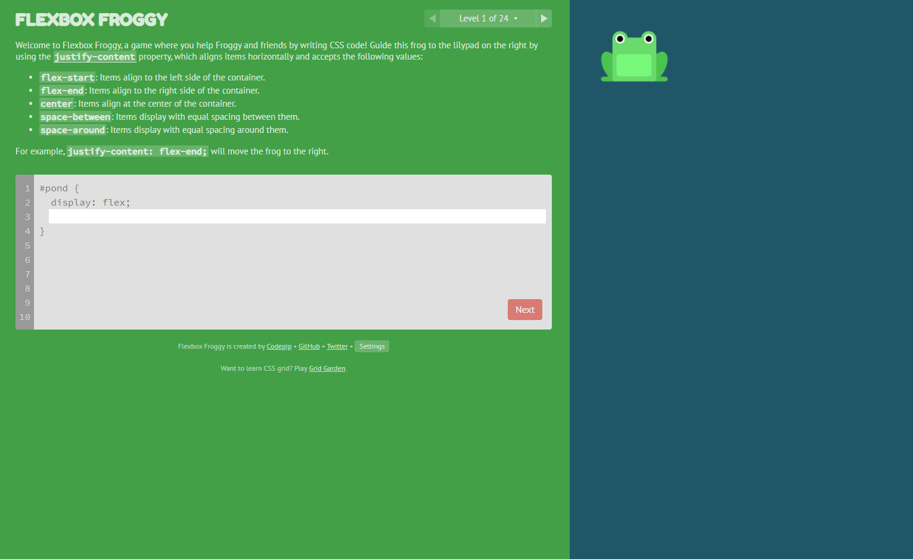

30 mins
#EXERCISE
Flexbox Froggy
Expand on your Flex knowledge and learn more through a game!
V
LET’S DISCUSS
https://flexboxfroggy.com/
Notes:
https://css-tricks.com/designing-a-product-page-layout-with-flexbox/

Slide 35
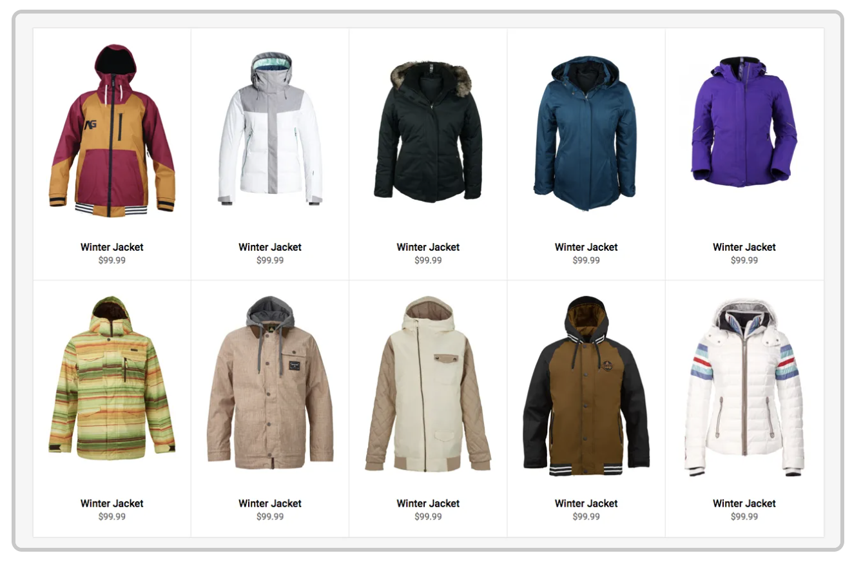
Official (Closed) - Non Sensitive
Case study : Product page with Flexbox & @media
https://css-tricks.com/designing-a-product-page-layout-with-flexbox/

Slide 36
Let’s Code
#EXERCISE
30mins
Power Up your Simple Recipe :P
See repl.it Project :
03 Simple Recipe with Flex
Continuing Education & Training (CET)

